Slide 1


Microprocessors and Microcontrollers
EC2003
WIRELESS MORSE CODE TRANSMISSION WITH PIEZOELECTRIC INPUT
PRESENTATION
November 2025

Slide 2
ROAD MAP
Phase 1: Research and Planning
PHASE 2: Transmitter design
PHASE 3:
Receiver design
PHASE 4:
Demostration
Studying RF module, piezoelectric material and their integration
Research paper presentation.
Building Piezo interface circuit.
Adding timer circuit and connecting it to RF Module.
Integration of piezo with rf.
Interfacing RF receiver to esp32 and LCD display.
Writing code in esp32.
Completion of prototype.
Testing and Optimization.
Demonstration and completion of course project.

Slide 3
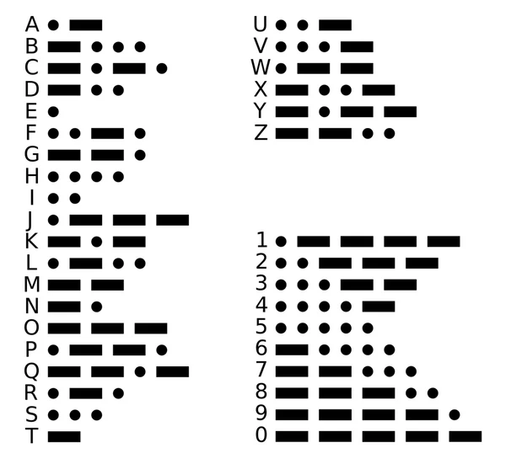
INTRODUCTION
We present a smart wireless Morse code decoder that bridges traditional communication with cutting-edge technology. Our system enables seamless transmission of Morse code messages using piezoelectric sensors and 433MHz RF technology, with real-time decoding and display on LCD screens. One of our main objective is to purely power the transmitter with battery instead of using any microcontroller and condition the high voltage spike (5-20V) of the piezoelectric disc so that it can pass through the circuit safely.

Slide 4


RESEARCH PAPER
Name
Author
Abstract
Source
Design and Analysis of Energy-Efficient Single-Pulse Piezoelectric Energy Harvester and Power Management IC for Battery-Free Wireless Remote Switch Applications
This paper presents a battery-free wireless switch using piezoelectric energy harvesting that generates 246 µJ from a single button press, enabling wireless message transmission over 10-meter distance
Minbok Lee, Joonseok Yang, Myeong-Jae Park, Sung-Youb Jung, E, and Jaeha Kim,
IEEE
Development of an Untethered Self-Moving Piezoelectric Actuator With Load-Carriable, Fast, and Precise Movement Driven by Piezoelectric Stack Plates (USPA)
This article introduces an untethered self-moving piezoelectric actuator that achieves high-speed movement, heavy payload capacity, and nanometer-scale precision using piezoelectric stacks and an onboard amplifier circuit.
Zhaochun Ding , Mingyang Cui , Jiang Wu , Wentao Wei , Xuewen Rong , IEEE, and Yibin Li
IEEE
This research developed haptic interfaces that reduce Morse code reception errors by 43.4% using bimanual location-based discrimination instead of traditional timing methods.
Tactile Morse Code Using Locational Stimulus Identification
Michael Walker and Kyle B. Reed
IEEE

Slide 5
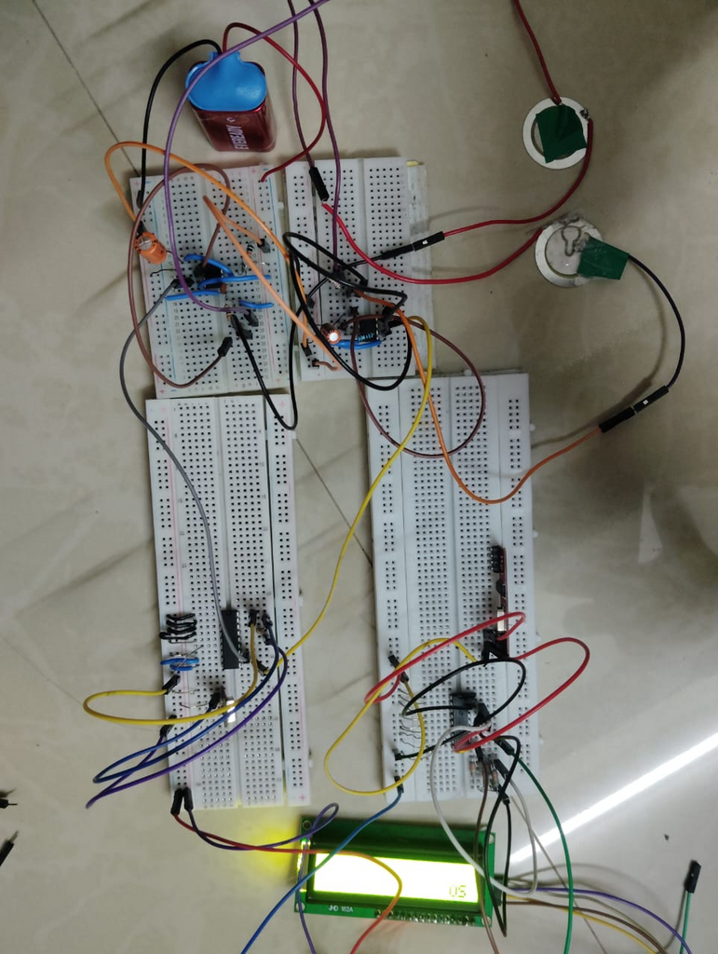
CURRENT SCENARIO
In this project, 2 piezo-discs are used to take input: one for dots, one for dashes.
Input is connected to a monostable 555 timer circuit to get clean digital pulses, which are sent to the HT12E encoder.
A 9V battery is used to power the transmitter circuit.
The HT12E encodes the parallel data into a serial format which is transmitted by the RF transmitter module.
RF receiver module collects the signal and relays the serial data to the HT12D decoder.
The decoder decodes it back into parallel data, which is passed to the ESP 32
The ESP32 translates the received Morse code data into letters, which are printed on the LCD

Slide 6
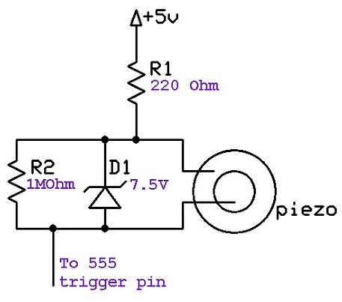
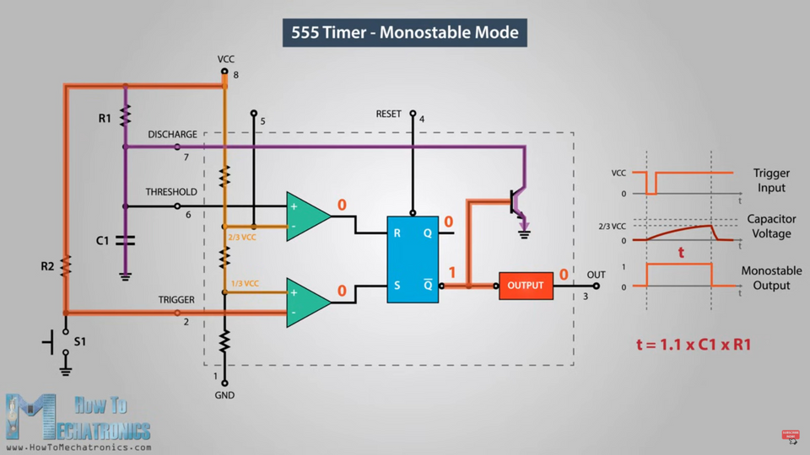
WORKING
Piezo Conditioning
555 Timer IC
As piezo output voltage is very high (up to 30V), it can damage the components and ICs connected to it, hence piezo conditioning is required. Two piezos are being used in the project - one for dot and the other for dash.
555 Timer ic is used to keep the signal on longer so that the data can be transferred without any loss of data as the voltage spikes from the conditioned piezo signal are of very short duration.

Slide 7
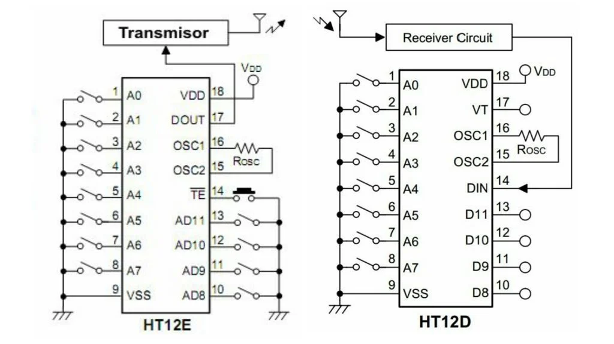
WORKING
Wireless Transmission
This is done with the help of encoder (HT12E) and decoder ICs (HT12D).
HT12e has parallel data lines, where pin 11 and 10 are connected to piezo 1 and piezo 2. The encoder sends serial data to the receiver through 433MHz RF module.
The receiver receives the serial data and HT12d decodes it back and gives data to esp32.
Esp32 decodes the dots and dashes and displays it on the I2C module LCD screen.

Slide 8
WORKING
#include<Arduino.h>
#include <Wire.h>
#include <LiquidCrystal_I2C.h>
LiquidCrystal_I2C lcd(0x27, 16, 2);
#define dotp 26
#define dashp 27
#define vt 25
volatile long lastSignalTime;
volatile int rear=0,i=0,j=0,b=0;
char temp[100];
volatile char a[100];
int lcdCol = 0;
int lcdRow = 0;
const char *morse_code[] = {
".-", "-...", "-.-.", "-..", ".", "..-.", "--.", "....", "..",
".---", "-.-", ".-..", "--", "-.", "---", ".--.", "--.-", ".-.",
"...", "-", "..-", "...-", ".--", "-..-", "-.--", "--.."
};
const char letters[] = {
'A', 'B', 'C', 'D', 'E', 'F', 'G', 'H', 'I', 'J',
'K', 'L', 'M', 'N', 'O', 'P', 'Q', 'R', 'S', 'T',
'U', 'V', 'W', 'X', 'Y', 'Z'
};
void enqueue(char b)
{
a[rear]= b;
rear=(rear+1)%100;
}
void dotfunc(){
lastSignalTime = millis();
if(digitalRead(vt)==HIGH)
enqueue('.');
}
void dashfunc(){
lastSignalTime = millis();
if(digitalRead(vt)==HIGH)
enqueue('-');
}
void setup() {
pinMode(dotp,INPUT);
pinMode(dashp,INPUT);
pinMode(vt,INPUT_PULLUP);
Serial.begin(9600);
attachInterrupt(digitalPinToInterrupt(dotp), dotfunc,FALLING);
attachInterrupt(digitalPinToInterrupt(dashp), dashfunc,FALLING);
lcd.init(); // Initialize the LCD
lcd.backlight(); // Turn on the backlight
lcd.setCursor(0, 0);
}
if (lcdCol >= 16) { // move to next line
lcdCol = 0;
lcdRow++;
if (lcdRow >= 2) { // if both lines are full
lcd.clear(); // clear the screen
lcdRow = 0;
}
lcd.setCursor(lcdCol, lcdRow);
} else {
lcd.setCursor(lcdCol, lcdRow);
}
break;
}
}
}
j=0;
}
else
temp[j++]=a[i];
a[i]=0;
i=((i+1)%100);
}
}
void loop() {
if (millis() - lastSignalTime > 3000 && lastSignalTime != 0) {
enqueue(' ');
lastSignalTime=millis();
}
while(i!=rear)
{
if (a[i] == ' ')
{
temp[j] = '\0';
Serial.println(temp);
if (j > 0) {
for (int k = 0; k < 26; k++) {
if (strcmp(temp, morse_code[k]) == 0) {
Serial.print(letters[k]);
lcd.print(letters[k]);
lcdCol++;

Slide 9
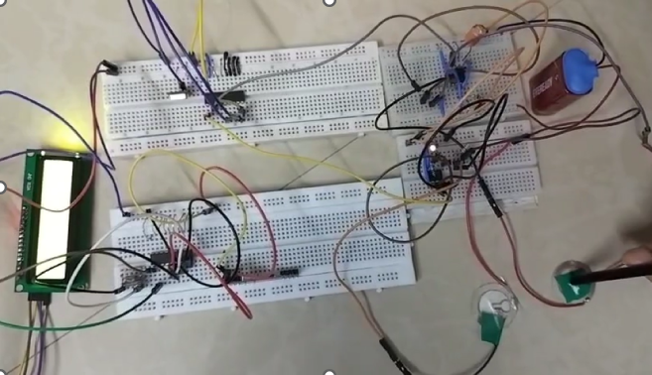
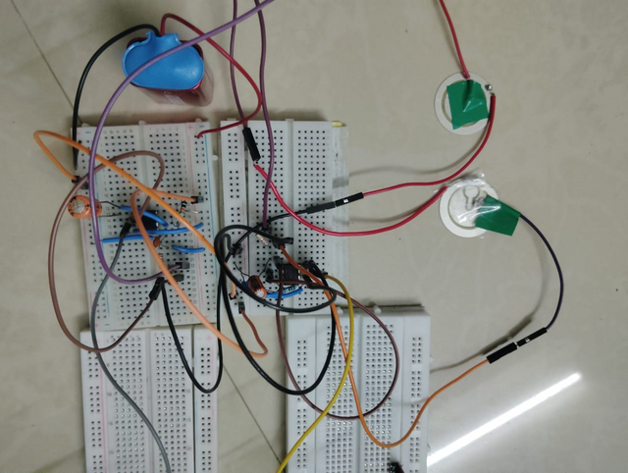
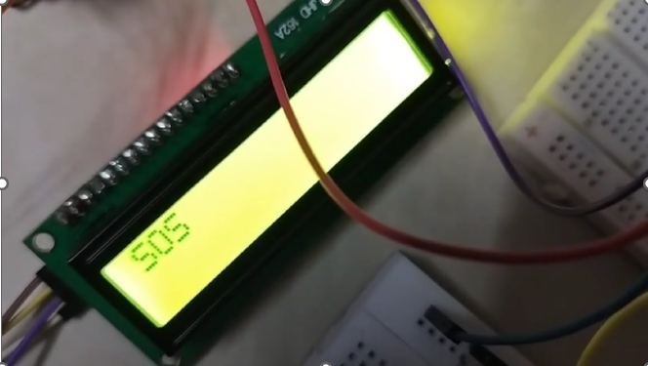
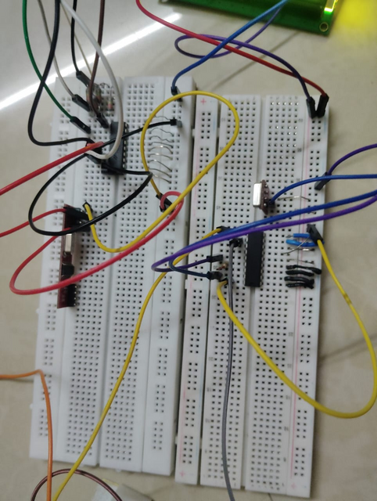
RESULTS
Full circuit
Transmitter circuit
Output
Receiver circuit

Slide 10
FUTURE ENHANCEMENT
Moving Toward Battery-Free Operation: Designing our circuit such that the energy harvested from the piezo press itself (or charges stored over several presses) powers the short transmission burst, eliminating or reducing the need for an external battery for the 555/HT21e/RF components.
Robust Signal Conditioning: We’ll consider using a operational amplifier or comparator circuit for rapid and reliable detection of the piezo's initial voltage peak, ensuring a clean trigger pulse for your 555 IC
Advanced Modulation & Protocols :using other types of modulation such as frequency shift keying instead of amplitude shift keying.

